Slide 1
Welcome to Open House
Algebra I
T. H. Rogers School
September, 21 2022

Slide 2
Agenda
  Introduction.
  Curriculum.
  Resources
  Grading Policy
  Late Work Policy
  Progress Report
  Contact Information & Communication
  Q & A

Slide 3
Introduction
This is my 9th year teaching math.
  I taught Geometry for 2 years at memorial high school .
  I taught math 7, algebra I, and geometry for last 6 years at T.H. Rogers.

Slide 4
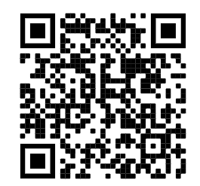
Curriculum Goals
  Algebra I is the high school credit course and is the foundation of high school mathematic courses.
  We follow HISD’s curriculum which is aligned with TEKS.
  Class syllabus

Slide 5
Resources
  Carnegie Learning
    Carnegie Book
      Online access
      Hard copy
    Mathia
  Study Island
  R 360

Slide 6
Grading Policy
  Learning (70%)
    Homework
    Quiz
    Class-works
  Assessment (30%)
    Test
    Project

Slide 7
Late Work Policy
  Missing assignment 10% off
  14 days to turn in assignment
  After 14 days, I do not accept late work and it turns to a zero

Slide 8
Progress Report
  Progress report will be sent home periodically.
  The progress report slip must be signed and returned the next school day.

Slide 9
Communication
  Please give me 24-48 hours _ 2 school days to respond your email.
  aaleali@houstonisd.org
  asal.aleali@houstonisd.org

Slide 10
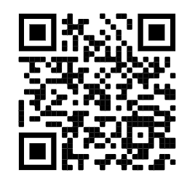
Q & A

Slide 11
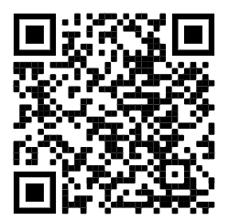
Contact info: aaleali@houstonisd.org
Algebra 1 Syllabus
Math 7 Syllabus
Q & R

